Slide 1
Big Data
Assignment 3

Slide 2
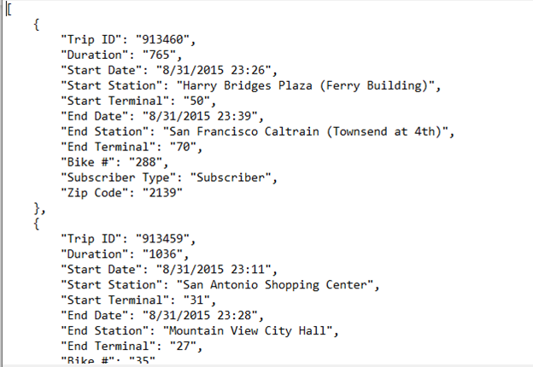
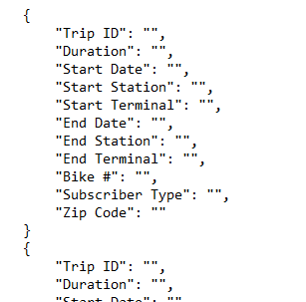
Event Hub Analytics - Data Preparation

Slide 3
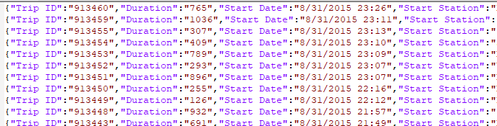
Event Hub Analytics - Data Preparation

Slide 4
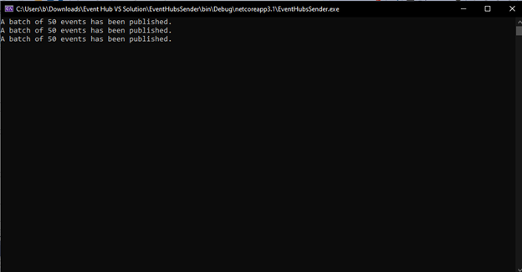
Event Hub Analytics - Sending Data

Slide 5
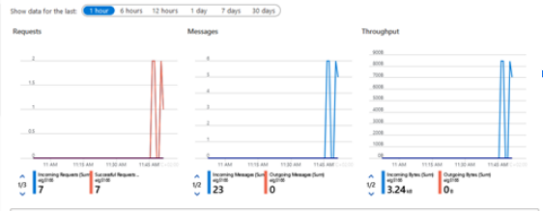
Event Hub Analytics - Sending Data

Slide 6
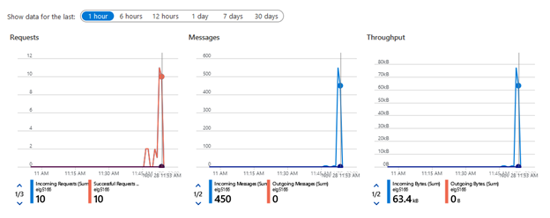
Event Hub Analytics - Sending Data
5 Minutes later!

Slide 7
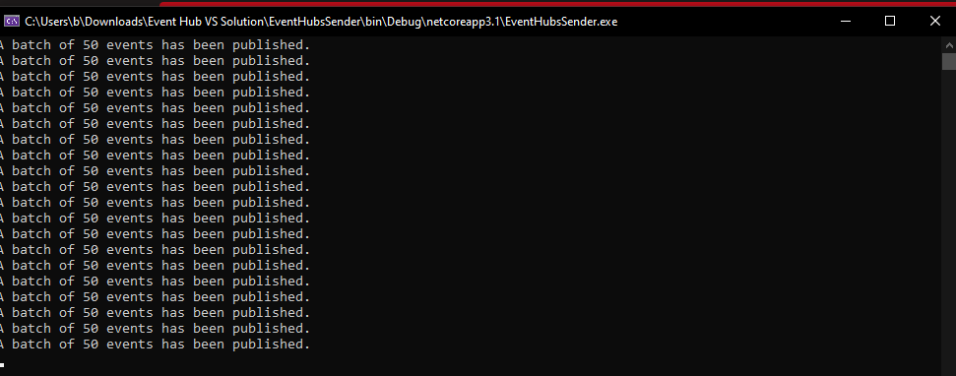
Event Hub Analytics - Sending Data
End of 20 batches

Slide 8
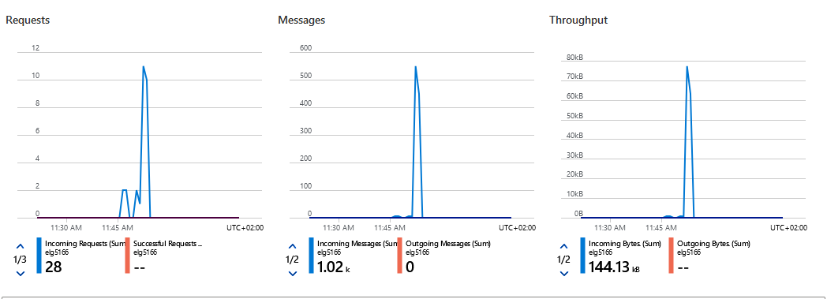
Event Hub Analytics - Sending Data
End of 20 batches

Slide 9
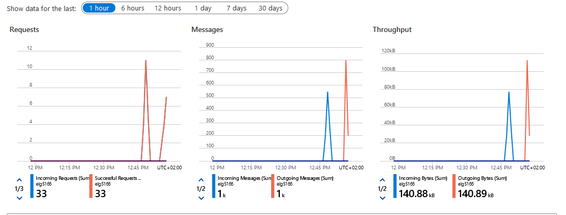
Receiving Data

Slide 10
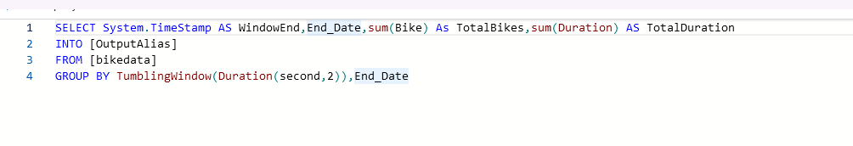
Stream Analytics

Slide 11
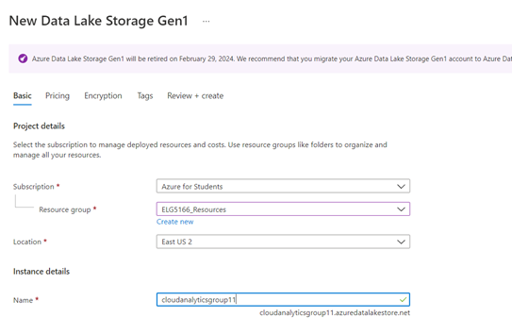
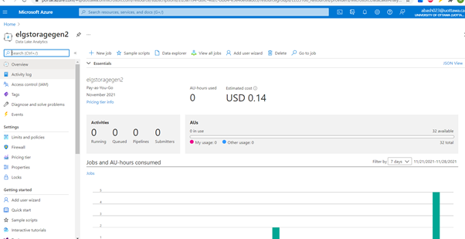
Stream Analytics
1) Create a Data Lake Storage Gen2 account.

Slide 12
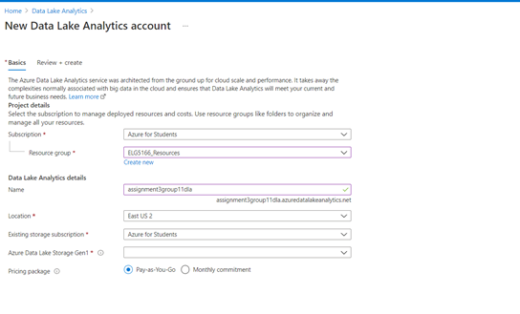
Stream Analytics
2) Setting Azure Data.

Slide 13
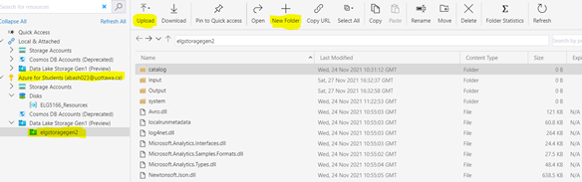
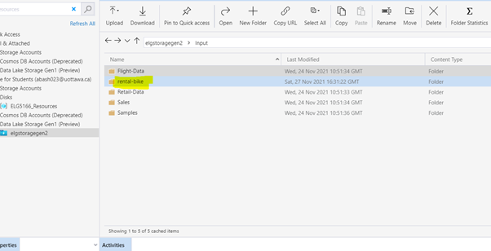
Stream Analytics
3) Microsoft Azure Store Explorer.

Slide 14
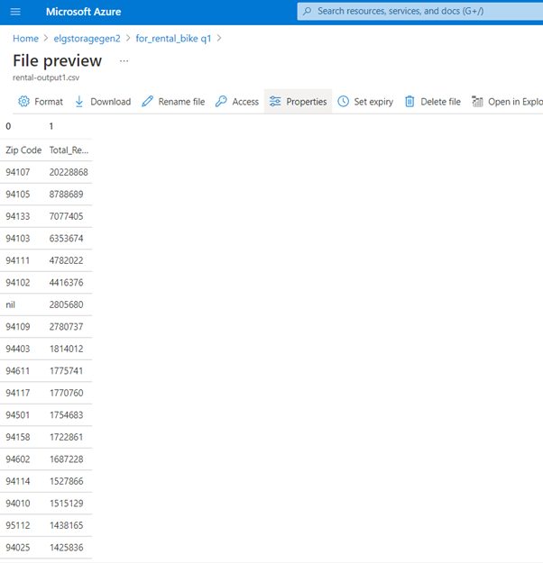
Azure Data Lake Analytics
1) Top 20 zip codes where most bikes were rented from.
We can notice that the top zip code is 94107 with 20228868 most rented bikes

Slide 15
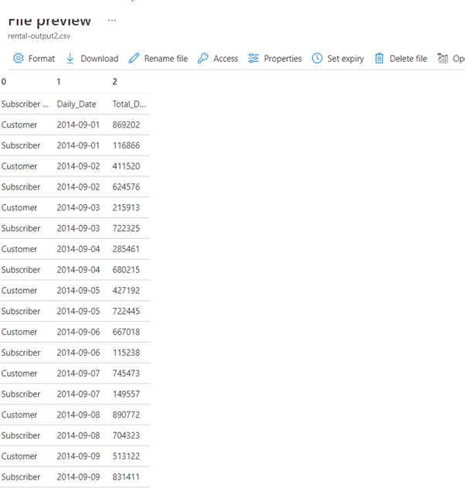
Azure Data Lake Analytics
2) Daily duration aggregate across the rental subscriber types.

Slide 16
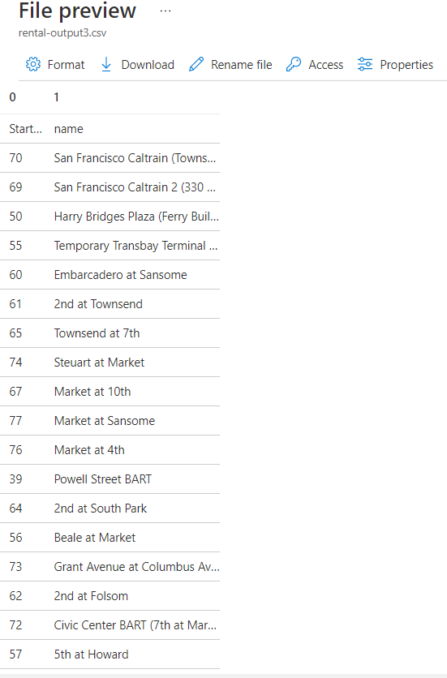
Azure Data Lake Analytics
3) The top busiest terminals for bike pickup.

Slide 17
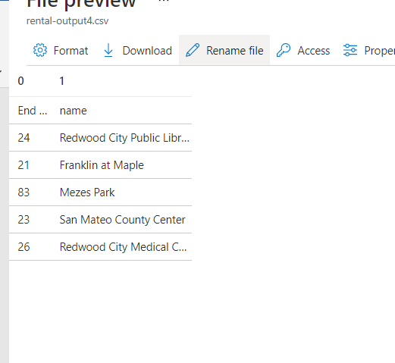
Azure Data Lake Analytics
4) The 5 terminal which has the least drop-offs.
These are the 5 least ones as they are not busy ( showing the first 5 results using Ascending order )

Slide 18
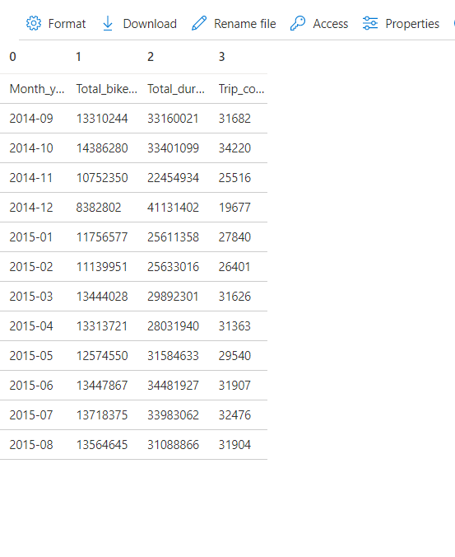
Azure Data Lake Analytics
5) The monthly summary of bike rentals (format - month/year ex. 06/2020).
These are the results of the bike rental showing the total bikes, total duration and trip count every month.

Slide 19
Thank You!

